Slide 1
Optical Illusions
By Dennis & jack

Slide 2
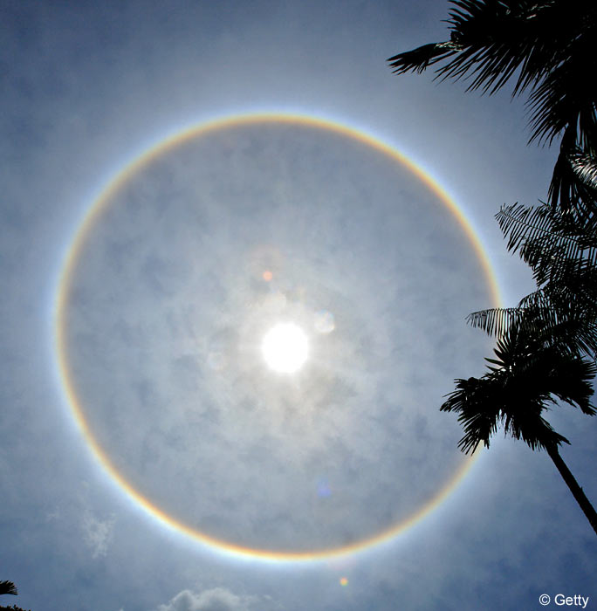
Can rainbows make a full-circle?
If you could get up high enough in the sky, then you'd see that some rainbows continue below the horizon. That's because when the sun and rain combine to make a rainbow, they really make a full-circle rainbow. We can't see all of the circle, because the horizon blocks it from our view. Pilots high in the sky do sometimes report seeing genuine full-circle rainbows.

Slide 3
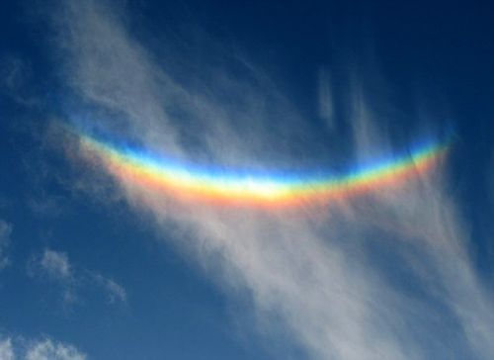
What is an upside-down rainbow?
An upside-down rainbow is an unusual phenomenon caused by sunlight shining through a thin, visible screen of tiny ice crystals high in the sky. Interestingly enough, it has nothing to do with rain. Some people refer to this as a 'smile rainbow'.

Slide 4
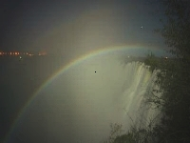
Can a rainbow appear during the night?
Yes, they're called moonbows! The nighttime rainbow is very rare and occurs only when the moon is bright enough and positioned properly with respect to falling rain to produce the beautiful effect.

Slide 5
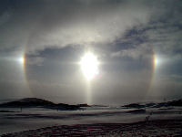
What are sun dogs?
Sun dogs are bright spots that appear on either side of the sun when there are thin layers of high ice crystal clouds otherwise known as Cirrus clouds. This can also happen at night. These are called moon dogs.

Slide 6
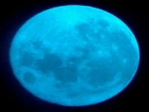
What is a blue moon?
The term is used when a full moon occurs twice in the same calendar month. It happens every 2.7 years and never in the month of February because there are not enough days. Is the moon really blue, though? It depends! Most moons are not blue, but if there is a volcanic eruption or even a forest fire, the smoke in the sky can turn the moon a blue color.

Slide 7
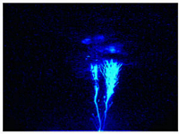
What are blue jets?
The blue jet appears as a blue column of light that squirts out the top of a thunderstorm at speeds of 62 miles per second. They sometimes reach a height of 25 to 30 miles. What exactly causes blue jets is not known.

Slide 8
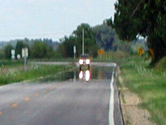
What is a mirage?
A mirage is a refraction phenomena in which the image of some object appears displaced from its true position. A common example of a mirage is the appearance of water some distance down the highway on a hot summer day.

Slide 9
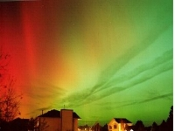
What are the Northern Lights?
The Northern Lights, commonly referred to as the Aurora Borealis, are the result of interactions between the Sun and Earth's outer atmosphere. They are one of the most spectacular light shows to watch as vivid colors glow in the sky. In the Southern Hemisphere, it is called the Aurora Australis.

Slide 10
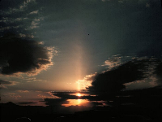
What are sun pillars?
Sun pillars are luminous vertical streaks of light, while or sometimes slightly reddish in color, extending from above and below the sun. They are the result of the light being reflected by the mirror-like surfaces of ice crystals. They are common to see around sunrise and sunset.

Slide 11
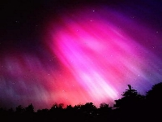
What causes the auoras?
Most auroras occur in response to energetic particles from a solar storm, which cause the gases of the thin upper atmosphere to glow. They take place at heights between 50 to 100 miles above the Earth. The aurora can last anywhere between a few minutes to several hours. Auroras are most common in polar regions. The various colors, of which green and red predominate, are the results of various light emissions from oxygen and nitrogen gases being energized by the solar particles.

Slide 12
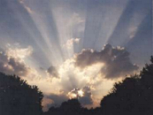
What are crepuscular rays?
Crepuscular rays are are bands of sunlight shining through breaks in clouds on the horizon.

Slide 13
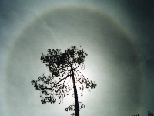
What is a halo?
A halo is a ring around the moon or sun produced by refraction of light through a thin cloud of ice crystals. The halo had red colors on the inside of the ring shifting to blue on the outside.

Slide 14
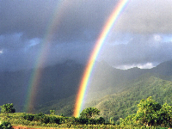
Are there double rainbows?
Yes, they do happen! The inner and brighter rainbow has the red on the top and the blue on the bottom side. The outer and dimmer rainbow has the colour scheme reversed.

Slide 15
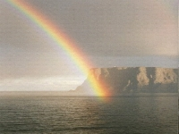
Why cant you ever find the end of a rainbow?
A rainbow is an optical illusion, so you just can't catch up to it. When you move, so does it!

Slide 16
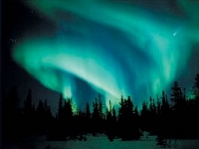
What causes he auroras?
Most auroras occur in response to energetic particles from a solar storm, which cause the gases of the thin upper atmosphere to glow. They take place at heights between 50 to 100 miles above the Earth. The aurora can last anywhere between a few minutes to several hours. Auroras are most common in polar regions. The various colors, of which green and red predominate, are the results of various light emissions from oxygen and nitrogen gases being energized by the solar particles.

Slide 17
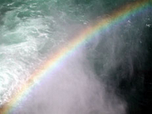
How do we get a rainbow
Rainbows are spectacular rays of colour. Sunlight looks white, but it's really made up of different colours...red, orange, yellow, green, blue, indigo, and violet. The sun makes rainbows when white sunlight passes through rain drops. The raindrops act like tiny prisms. They bend the different colours in white light, so the light spreads out into a band of colours that can be reflected back to you as a rainbow.

Slide 18
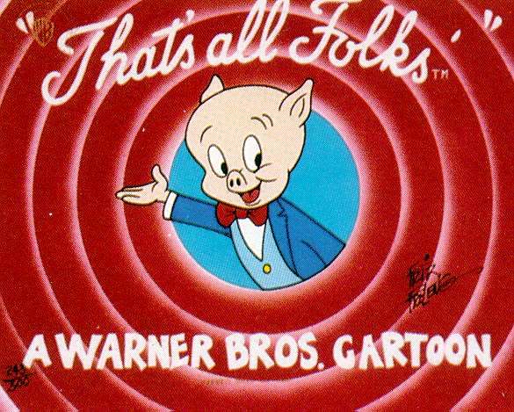
Thank you for watching this by Dennis & Jack

